Slide 1
Assessing Human Error Against a Benchmark of Perfection
Acm Sigkdd International Conference on Knowledge Discovery & Data Mining , 2016
Zhou Chao

Slide 2
Aim：Model systems for studying human error
Rrequirement：
(i) It should consist of a task for which the context of the human decisions has been measured as thoroughly as possible, and in a very large number of instances, to provide the training data for an algorithm to analyze errors
(ii) The task is non-trivial, it should be challenging even for highly skilled human decision-makers
(iii) The “ground truth” — the correctness of each candidate decision — should be feasibly computable by an algorithm

Slide 3
Chess: A perfect model system for human error
Initial ideas ：
(i) The clean formulation of the decisions made by human chess players.
(ii) The availability of databases with millions of recorded chess games by strong players.
(iii) The definition of chess a deterministic game with two players (White and Black) who engage in alternating moves, and with a game outcome that is either (a) a win for White, (b) a win for Black, or (c) a draw

Slide 4
Assessing errors using tablebases
In our work, we use minimax values by leveraging a further development in computer chess — the fact that chess has been solved for all positions with at most k pieces on the board, for small values of k.
Proprietary tablebases with k = 7 have been built, requiring in excess of a hundred terabytes of storage, and we focus on the case of k = 6 in what follows.

Slide 5
Our model system for analyzing human error
Chess positions with at most k = 6 pieces arise relatively frequently in real games.
Despite their simple structure, they can induce high error rates by amateurs and non-trivial error rates even by the best players in the world.
They can be evaluated perfectly by tablebases.

Slide 6
Definition of blunders
Concrete and precisely aligned with the minimax value of the game tree.
“Softer” notions of blunders, produces a much higher empirical probability that the opponent will make a mistake at some future point and lose.

Slide 7
Features
the skill of the decision-maker.
the time available to make the decision.
the inherent difficulty of the decision
Task Definition
To summarize, in a single instance in our data, a player of a given rating, with a given amount of time remaining in the game, faces a specific position on the board, and we ask whether the move they select is a blunder.

Slide 8

Dataset
There are 24.6 million (non-losing) instances in the FICS dataset, and 880,000 in the GM dataset.
Some Definition
N(P) —— number of legal moves available in a given chess position P
B(P) —— number of blunder moves available in a given chess position P
Blunder Potential —— = B(P)/N(P).

Slide 9
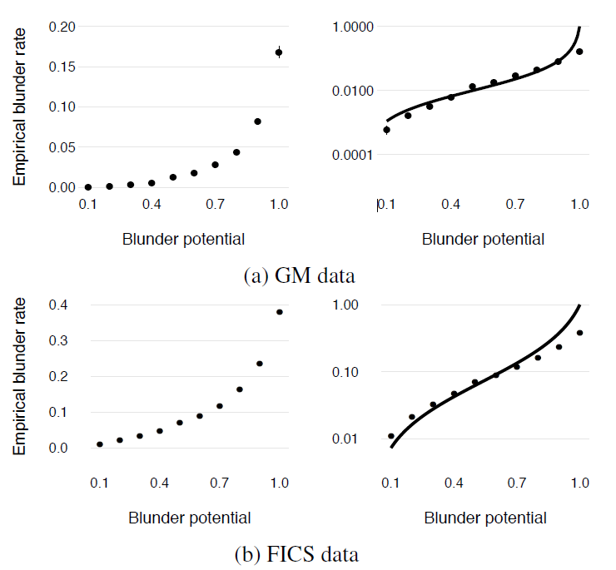

Slide 10

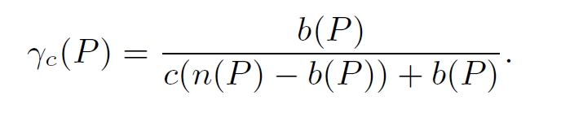
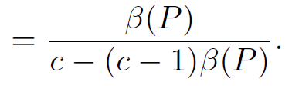
A player selected from a biased distribution in which they were preferentially c times more likely to select a non-blunder than a blunder, for a parameter c > 1.
The empirical blunder rate of a position P would be:
Best-fit values of c are c = 15 for the FICS data and c = 100 for the GM data.

Slide 11
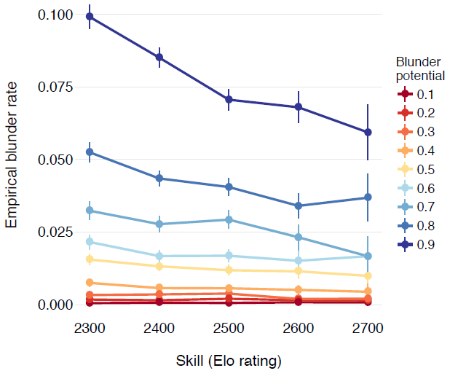
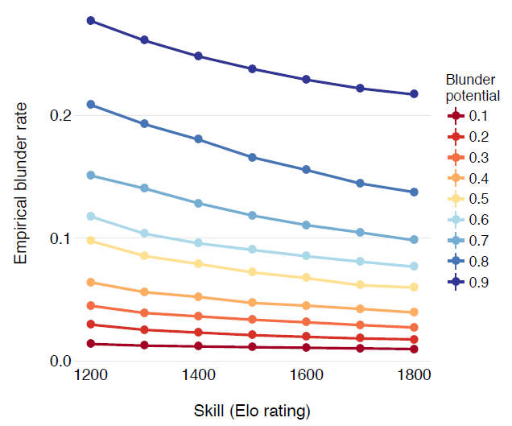
Skill

Slide 12
Skill
There is remarkably little variation among the curves. When viewed on a logarithmic y-axis the curves are almost completely parallel
A second, arguably more striking, property is how little the curves overlap in their ranges of y-values

Slide 13
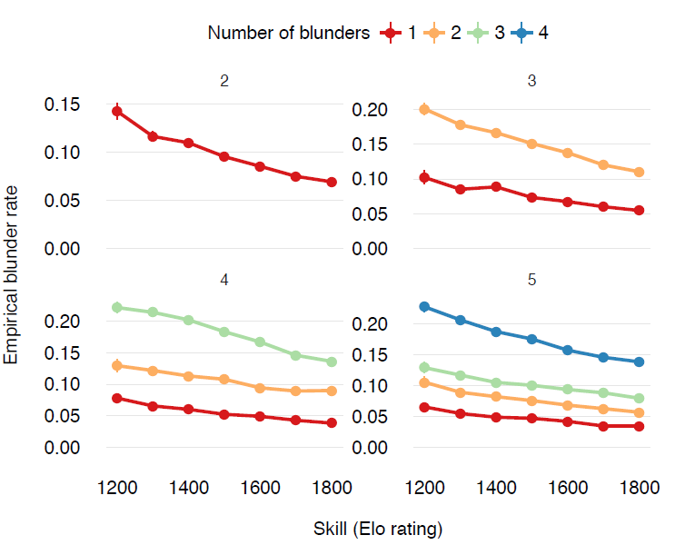
Skill-fixed values of (N(P), B(P))

Slide 14
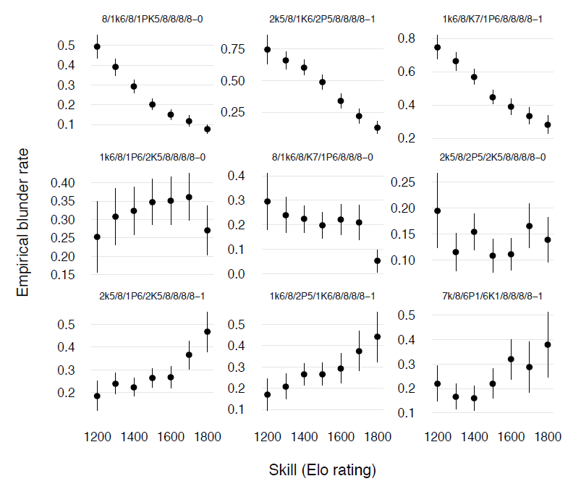
Skill-fixed position

Slide 15
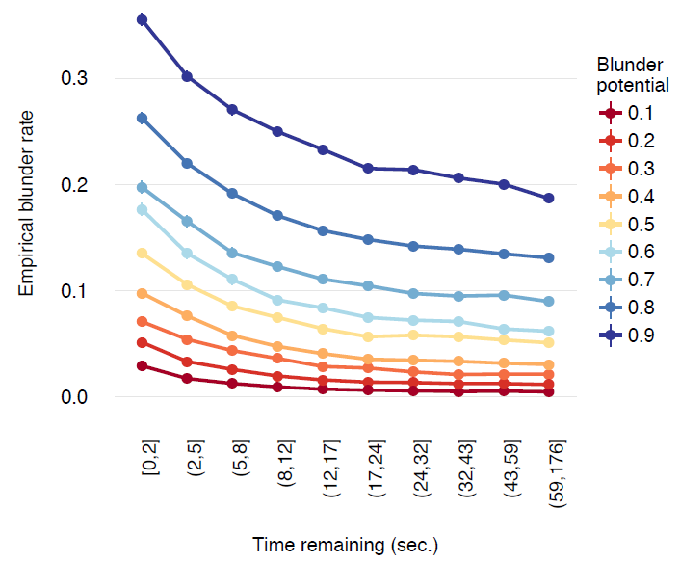
Time

Slide 16
Time
It shows a very similar “ladder” structure in which the role of blunder potential is dominant

Slide 17
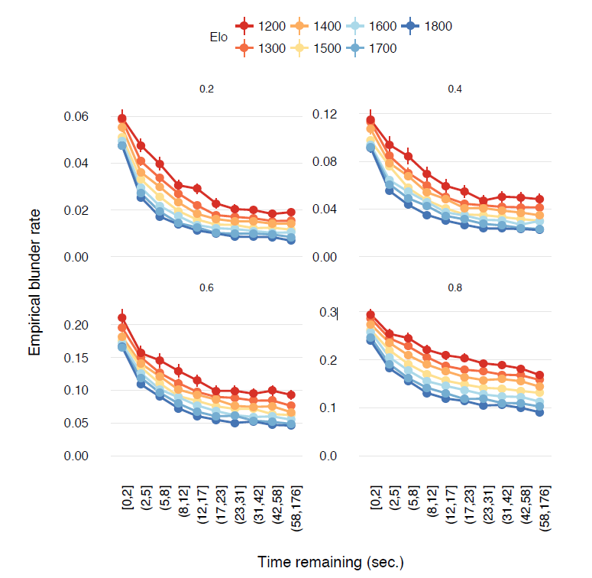
Time-fixed blunder potential and player rating

Slide 18
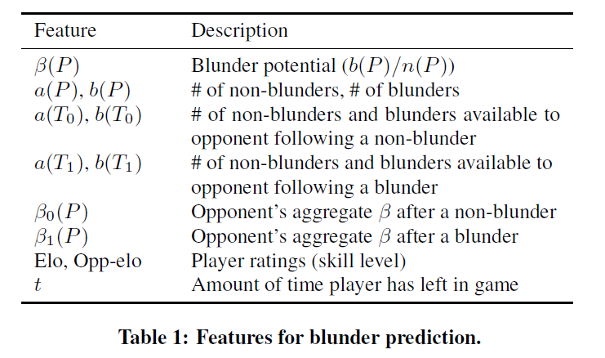
Prediction – Task1
Task 1: we want to predict whether the decision-maker will err or not.

Slide 19
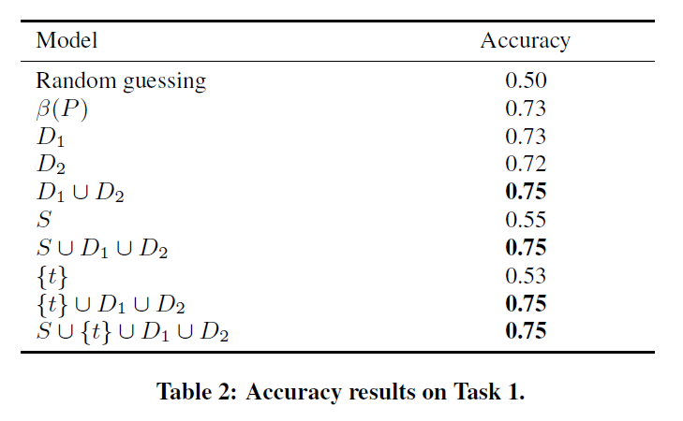
Prediction – Task1

Slide 20
Prediction – Task2
Task 2: we now control for b(P) and n(P) and investigate the predictive performance of our features once blunder potential has been fixed.
In all cases, the performance of the full feature set is best (the mean accuracy is 0.71), but D2 alone achieves 0.70 accuracy on average.

Slide 21
Prediction – Task3
Task 3: the degree to which time and skill are informative once the position has been fully controlled for.
On average, knowing the rating of the player alone results in an accuracy of 0.62, knowing the times available to the player and his opponent yields 0.54, and together they give 0.63.

Slide 22
Thanks

